Slide 1

Women with Diabetes: Health Throughout
The Life Cycle
Dawn Adams
Person Living with Diabetes, Mother, Midwife & Advocate

Slide 2

All graphics belong to and are used with the consent of @katie_t1d_artist

Slide 3


Slide 4
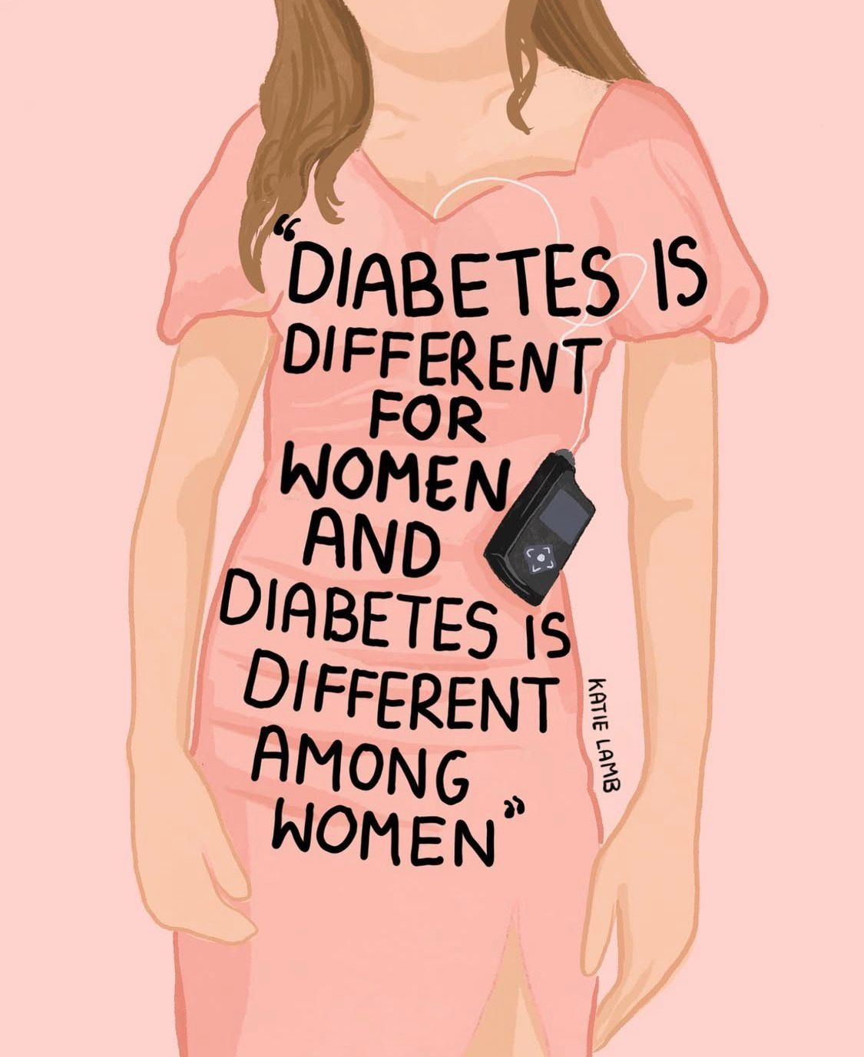
Puberty
💉Puberty causes decreased insulin sensitivity, even in healthy-weight girls. The body requires more insulin to manage glucose.
🧬Oestrogen & increased growth hormone impact insulin activity, making it harder for the body to regulate glucose levels.

Slide 5
⚖️ Rapid growth & changes in body fat distribution affect how glucose is stored & used. Increased mass, especially around the abdomen, can further reduce insulin sensitivity. These changes require adjustments in insulin dosing, dietary habits & activity levels to support glucose levels.
😣 Emotional & psychological stress from school, social pressures, body image concerns etc can lead to disordered eating habits, including skipped meals, further impacting glucose levels.

Slide 6

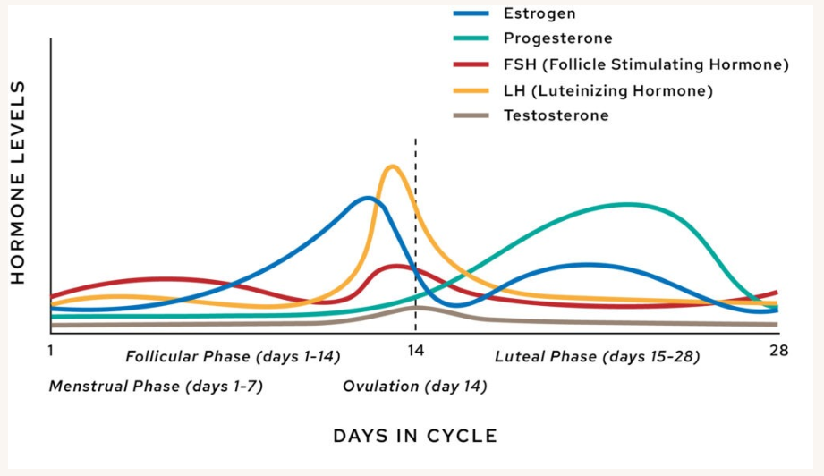
Menstruation

Slide 7
🔄Progesterone increases insulin resistance pre-period, while increased oestrogen post-period can cause unexpected hypoglycaemia
🍫 Cravings & appetite changes lead to glucose spikes if not balanced with insulin or physical activity. Planning meals may help mitigate these effects.
😣 Emotional stress, disturbed sleep & PMS may also cause cortisol to be released, which affects circulating glucose levels.

Slide 8




Pregnancy
During pregnancy, the placental hormones human placental lactogen (hPL), oestradiol, cortisol & progesterone support foetal development.
Insulin action is impacted, causing lower glucose in the 1st trimester, and higher glucose in the 2nd & 3rd trimesters.
The hormonal impact on glucose disposal is why women develop gestational diabetes, particularly towards the end of the 2nd trimester and during the 3rd trimester.

Slide 9
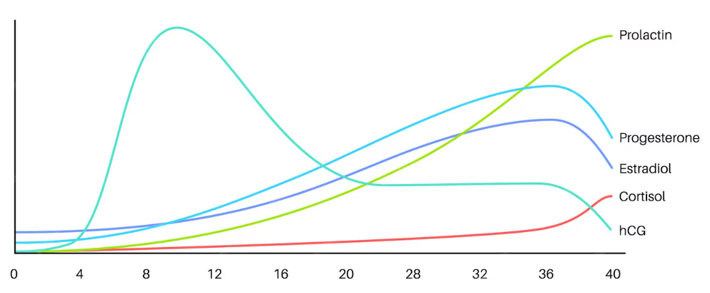


💉 During pregnancy, hCG levels reduce while prolactin and progesterone levels increase, meaning the body naturally becomes more insulin-resistant to ensure the foetus receives enough glucose. This requires regular adjustments in insulin therapy to optimise blood glucose levels.

Slide 10

🥗 Alongside pregnancy hormones, what, when, and how much a woman eats affects glucose levels. Managing meal timing & portion sizes is essential to maintaining both energy and glucose levels throughout the day.
Insulin pump therapy has been recognised as a significant support tool for pregnancy. The only licensed hybrid closed-loop pumps are the Ypsomed or Dana-i with CamAPS. The Medtronic 780g is also available. In the UK, HCL is limited to women with T1D, but CGM is increasingly available for women with T2D and some women with GDM.

Slide 11



Regular, moderate exercise helps to
lower blood glucose by increasing insulin sensitivity & promoting glucose uptake by muscles.
Walking, swimming, or antenatal yoga can be beneficial, but should be tailored to the individual's pregnancy & health status.

Slide 12

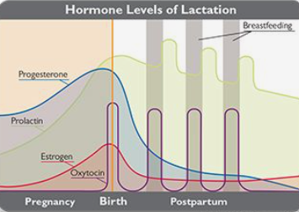
Breastfeeding

Slide 13
Breastfeeding
🔄After birth, oestrogen & progesterone levels drop, while leptin & prolactin levels rise to support milk production. Hormone fluctuations can affect mood & appetite, indirectly influencing glucose levels.
🤱 Breastfeeding can lower blood glucose levels during or immediately after feeding. As glucose is converted to lactose, regular breastfeeding can lead to hypoglycemia.
😣 Stress, infection & sleep also affect glucose levels.

Slide 14
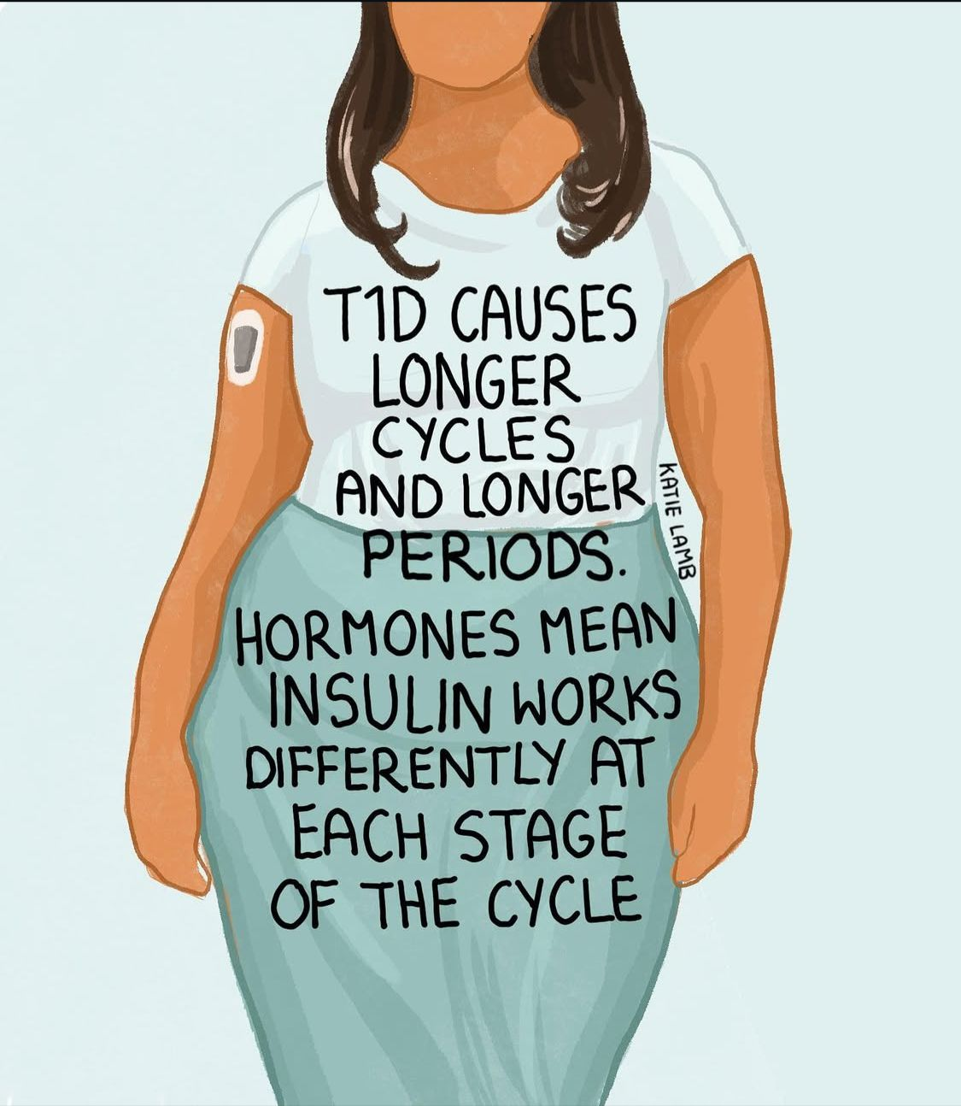
Perimenopause
🔄Perimenopausal shifts in oestrogen & progesterone, directly impact responses to insulin.
💉As oestrogen declines, women experience greater insulin resistance and higher glucose levels, even if diet & activity remain unchanged.
😴Night sweats, hot flushes & insomnia, interfere with sleep quality, increasing stress hormones, and raising blood glucose levels.
⚖️ Mood swings & irregular cycles further complicate management.

Slide 15
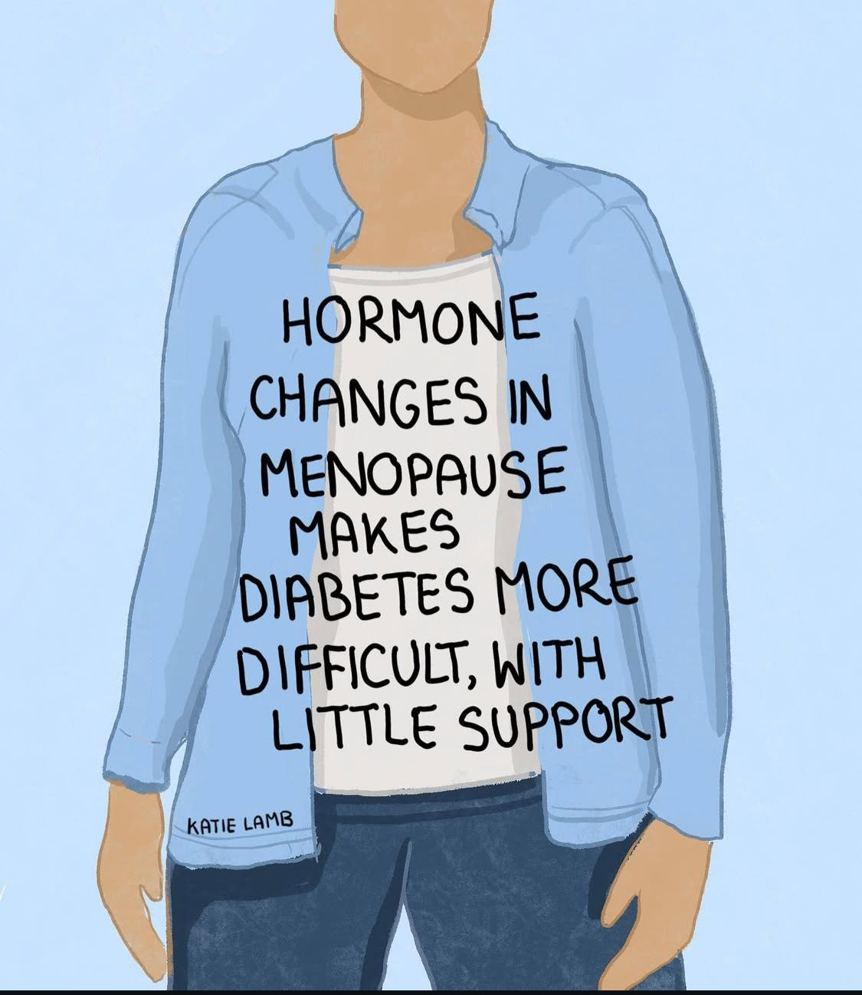
Post Menopause
❤️ Reduced oestrogen leads to higher risks of heart disease & stroke. Women with diabetes have an 88% increase in cardiovascular risks.
⚖️ Visceral fat around internal organs increases insulin resistance and the risk of metabolic syndrome, which significantly raises the risk of heart disease & stroke.
🦴 Oestrogen helps maintain bone strength. Its decline leads to osteopenia & osteoporosis. Diabetes further compromises bone quality, increasing the risk of fractures, especially in the hips & spine.

Slide 16

Additional considerations
❤ Women with Type One diabetes have an 88% increased risk of hypertension, heart disease & stroke, even when confounding factors are removed or accounted for. This is further compounded by any history of pre-eclampsia in pregnancy.
🦴Women with diabetes have an increased risk of osteoporosis and osteopenia

Slide 17
🧠High glucose levels over time can damage blood vessels and brain cells, contributing to cognitive decline & dementia.
👩‍🔬 A meta-analysis of >2.3m people found women with diabetes had a significantly higher risk of dementia than men with diabetes, possibly due to
- longer life expectancy
- reduced oestrogen affecting neuroprotection & increasing insulin resistance.

Slide 18
🧬Vascular complications often accelerate dementia risk. Differences in healthcare access, diagnosis timing, and treatment appropriateness and availability may also play a role.
🧩Seeing the whole spectrum of reproductive health stages, supporting and promoting lifestyle interventions, including exercise, a balanced diet & mental stimulation across the lifespan, can help to reduce these risks, and improve quality of life

Slide 19
💉 GLP1-RA therapy is increasingly being made available to, and used by, women with diabetes.
Current published evidence is limited, but ongoing clinical trials indicate its safety.
Inform your diabetes team if you are using it without it having been prescribed by them.
Everyone’s diabetes is different, there is no one-size fits all with this condition.

Slide 20

Thank you

Slide 21
References
Adams, D., & Nsugbe, E. (2022). A pilot on the endocrine effects of hormonal replacement therapy on menopausal T1 diabetics using wearable sensors. Engineering Proceedings, 27(1), 19.
Benhalima, K., Durnwald, C., Sweeting, A., et al. (2025). Application of continuous glucose monitoring and automated insulin delivery technologies for pregnant women with type 1, type 2, or gestational diabetes: An international consensus statement. The Lancet Diabetes & Endocrinology, 14, 157–177.
Benhalima, K., Mathieu, C., Napoli, A., et al. (2025). Safe options for the treatment of mothers and babies with pregestational diabetes. Diabetes Technology & Therapeutics, 27(2), 91–92.
Cao, F., Yang, F., Li, J., et al. (2024). The relationship between diabetes and the dementia risk: A meta-analysis. Diabetology & Metabolic Syndrome, 16, 101. https://doi.org/10.1186/s13098-024-01346-4
Chadalavada, S., Jensen, M. T., Aung, N., Cooper, J., Lekadir, K., Munroe, P. B., & Petersen, S. E. (2021). Women with diabetes are at increased relative risk of heart failure compared to men: insights from UK biobank. Frontiers in cardiovascular medicine, 8, 658726.
Dorman, J. S., Steenkiste, A. R., Foley, T. P., Strotmeyer, E. S., Burke, J. P., Kuller, L. H., & Kwoh, C. K. (2001). Menopause in type 1 diabetic women: is it premature?. Diabetes, 50(8), 1857-1862.
Gioacchini, F. M., Pisani, D., Viola, P., Astorina, A., Scarpa, A., Libonati, F. A., Tulli, M., Re, M., & Chiarella, G. (2023). Diabetes Mellitus and Hearing Loss: A Complex Relationship. Medicina (Kaunas, Lithuania), 59(2), 269. https://doi.org/10.3390/medicina59020269
Hossmann, S., Tan, S., Mader, J. K., Klonoff, D. C., Adams, D., Ballhausen, H., ... & Rothenbühler, M. (2025). One size does not fit all: the need for sex-specific precision medicine in diabetes technology. Journal of Diabetes Science and Technology, 19322968251340673.
Feig, D., Donovan, L., Corcoy, R., et al. (2017). Continuous glucose monitoring in pregnant women with type 1 diabetes (CONCEPTT): A multicentre international randomised controlled trial. The Lancet, 390, 2347–2359.
FIGO Pregnancy Passport (2023) https://www.figo.org/figo-resources/postnatal-health/pregnancy-passport

Slide 22
Forde, R., King, L., Cooper, A., Winkley, K., & Coates, V. (2024). Type 1 diabetes and menopause, what women would like to know: a public and patient involvement exercise. International Diabetes Nursing, 17.
Gamarra, E., & Trimboli, P. (2023). Menstrual cycle, glucose control and insulin sensitivity in type 1 diabetes: a systematic review. Journal of Personalized Medicine, 13(2), 374.
Lee, T. T., Collett, C., Bergford, S., Hartnell, S., Scott, E. M., Lindsay, R. S., ... & AiDAPT Collaborative Group. (2024). Automated closed-loop insulin delivery for the management of type 1 diabetes during pregnancy: the AiDAPT RCT. Efficacy and Mechanism Evaluation, 11(7), 1-80.
Mackay, L., Horsburgh, D., & Kilbride, L. (2014). How women manage their type 1 diabetes during the menopausal transition: a qualitative study using a grounded theory approach. Practical Diabetes, 31(4), 149-154.
Dib, S., Savage, M.J., Adams, D., et al, (2026) Preconception, pregnancy and postnatal use of GLP-1RA based therapies in diabetes: a systematic review and international expert consensus statement on clinical need and human safety data in women with type 1, type 2 or gestational diabetes. The Lancet Obstetrics, Gynaecology, & Women’s Health.
Mewes, D., Wäldchen, M., Knoll, C., Raile, K., & Braune, K. (2023). Variability of glycemic outcomes and insulin requirements throughout the menstrual cycle: a qualitative study on women with type 1 diabetes using an open-source automated insulin delivery system. Journal of diabetes science and technology, 17(5), 1304-1316.
National Institute for Health and Care Excellence. (2024). Menopause: Identification and management (NICE Guideline NG23). https://www.nice.org.uk/guidance/ng23
Ringholm, L., Mathiesen, E. R., Kelstrup, L., & Damm, P. (2012). Managing type 1 diabetes mellitus in pregnancy: From planning to breastfeeding. Nature Reviews Endocrinology, 8(11), 659–667. https://doi.org/10.1038/nrendo.2012.154
Sharma, P., Sharma, R. K., & Gaur, K. (2024). Understanding the impact of diabetes on bone health: A clinical review. Metabolism open, 24, 100330. https://doi.org/10.1016/j.metop.2024.100330
Sjöberg, L., Pitkäniemi, J., Harjutsalo, V., Haapala, L., Tiitinen, A., Tuomilehto, J., & Kaaja, R. (2011). Menopause in women with type 1 diabetes. Menopause, 18(2), 158-163.
Walsh C H, Malins J M(1977) Menstruation and control of diabetes. British Medical Journal; 2 :177 doi:10.1136/bmj.2.6080.177

